Slide 1
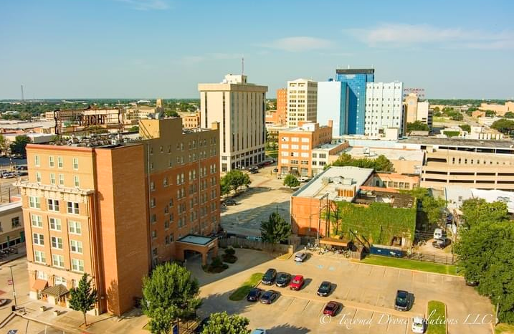

Downtown Zoning Realignment Work Session
Wichita Falls Planning & Zoning Commission
June 8, 2022

Slide 2
Downtown Zoning Diagnostic: Freese & Nichols
Report outlines 14 recommendations, addressed through:
Zoning
Development Process
Economic Development
Implementation Schedule: high, medium, low impact
Zoning realignment – high impact
Update CBD – high impact
Revise RDD regulations – low impact
Adopt Property Maintenance Code – high impact
Resolve parking issues in downtown area – low impact
Amend outdoor dining ordinance to reflect streetscape recommendations – low impact
Notes:
Council adopts Downtown Strategic Plan Recommendations – September 2018; Downtown Zoning Diagnostic Report a key element
Implementation of Diagnostic Report aims to address 6 of the 14 recommendations; including the top 3
Diagnostic Report: Access to a digital copy using QR Code for smart device users
GREEN Recommendations – items that will be completed through the Downtown Zoning Realignment Project
High impact - considered to cause a significant change on the design, land use and organization of downtown; maybe difficult or costly
Medium impact on revitalization; can be implemented any time and less difficult to implement
Low impact on revitalization but should still be implemented; considered cost effective and easiest to pursue
Key Elements of Council Downtown Strategic Plan:
Diagnostic Report
Downtown Funding Possibilities Report – outlines various programs (local, state & federal) for potential project assistance and other downtown resources; available on the City’s website
4B Matching Grant Program – enhanced funding and expanded scope to include sidewalk repairs, tree removal/tree well repairs, etc. Defined boundary within the CBD
TIF #4 Board – Downtown Reinvestment Zone – created in 2015 – activated to review project plan and establish funding priorities

Slide 3
Downtown Strategic Plan: Progress to Date
Code Enforcement: zones realigned for improved service downtown
TIF #4 board activated – increment allocation in 2020
Downtown Improvement Grant (4B):
Increased funding level FY18-19 by $50,000 to assist with sidewalk, curb/gutter, tree well repairs
Public Works assessed sidewalks for deficiencies; owners/tenant notified & utilizing program for improvements
Downtown Property Maintenance Code (PMC) & Vacant Structure Registry (VSR):
Feb. 2021: council approves both PMC and VSR
Oct. 2021: ordinances became effective; applies to non-residential properties
Parking Issues:
Lindemann Parking Garage Project and Arts Collaborative
RAISE Grant:
Rebuilding American Infrastructure with Sustainability & Equity – DOT funds;
$25M application to assist with downtown infrastructure improvements
Notes:
Downtown TIF Board Actions:
2018 – Discuss project & funding priorities; 2019 - Allocate funding for focused streetscape improvements on 8th Street
2020 - Indiana Ave Nat’l Register District funding for research & creation – partnership with DWFD Inc.
PMC – stakeholder group initiated in 2019; virtual public forum 2020
Only greater downtown
Applies to non-residential properties; addresses exterior maintenance
Focus on building security and safety, doors & windows repaired & secured and roofs free from defects and drain properly
VSR
Greater downtown area
Applies to non-residential properties
Ensures vacant property owners are known to the City & can be contacted
Ensure owners aware of obligations under City codes
Ensure minimum standards of maintenance are met
Vacant structure defined as:
- habitable structure
- not currently occupied
- an inactive city utility account
- used solely for purpose of personal/business storage
- actively listed for sale or lease a min. 90 days
Annual registry of vacant structures until occupied
BUILD Grant – Better Utilizing Investments to Leverage Development via DOT – competitive, discretionary transportation funds that would address
implementation of the Streetscapes Plan; 10% local match requirement
RAISE Grant – Reformulated in 2021 as Rebuilding American Infrastructure with Sustainability and Equity – discretionary DOT funds

Slide 4
Downtown Zoning Realignment – Project Meetings
Dec. 9, 2021: Public Forum Project Launch for owners/tenants – MPEC
2022
March 28: Area meeting #1 – River Development District-Downtown (RDD-D)
March 31: Area meeting #2 – Central Business District (CBD)
April 5: Area meeting #3 - Light Industrial-Downtown District (LI-D)
April 6: Area meeting #4 – General Commercial-Downtown District (GC-D)
April 21: Economic Development Corporation/4A Board Update
June 7: City Council Project Updates
June 8: Planning & Zoning Commission Work Session
Notes:
Numerous opportunities for both downtown property owners (800+) & general public to comment or attend meetings to provide input in this process.
Significant effort put into promoting meetings, notifying property owners from the City, Downtown Wichita Falls and the media.
Initial public launch - Zoning Diagnostic Project Implementation: December 2021
Initial mailings to 600+ property owners informing of public forum in December.
Letters/map mailed to 183 property owners with land identified as part of the realignment areas.
Followed by a core series of meetings focused on each of the 4 downtown zoning districts:
Notification mailed to all property owners of record for area meetings (March - Wichita Co Appraisal data);
- Postcard mailers to property owners (478) within greater downtown, duplicate ownership listings removed - Press release to media outlets
Updates presented to the EDC and yesterday at City Council encouraging residents to attend today’s work session and provide feedback.

Slide 5
Proposed Revisions – Greater Downtown
Special Downtown Zoning Category – 4 zones
Zoning District Boundary Realignment
Downtown Zoning Use Table
Development Standards – Reduce Setbacks
Non-Conforming Use - Time Limitation & Appeal Process
Incorporate Defined Uses Section for Downtown
Address Definition Updates:
Household Care Facility
Structured Sober Living Facility
Land Use Plan Amendment – Consolidate Categories

Slide 6
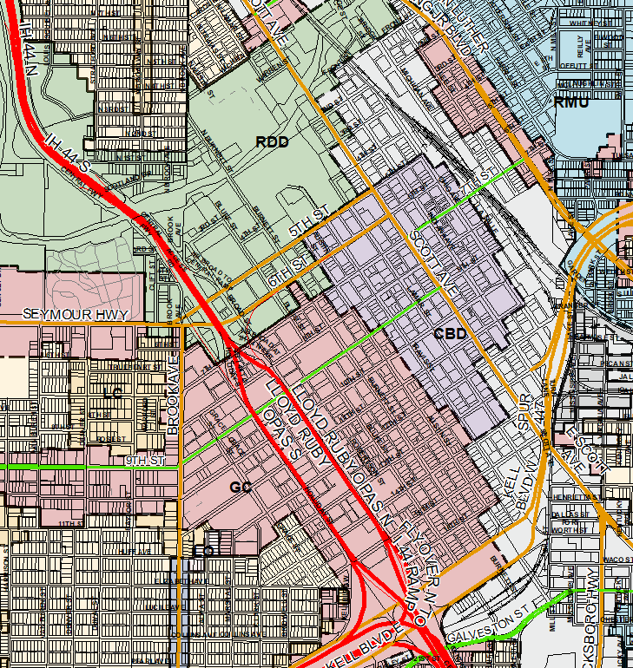
Zoning Uses
What is Zoning?
Division of a city into areas, or zones, which specify permitted and prohibited
land uses for real property and size restrictions for buildings within these areas.
Zoning Districts Downtown:
Existing Zones: Proposed Zones:
Central Business District Central Business District
General Commercial General Commercial - Downtown
River Development District River Development District - Downtown
Light Industrial Light Industrial - Downtown
What is a Zoning Boundary?
Limit and extent of each zoning district classification;
generally depicted on a map.

Slide 7
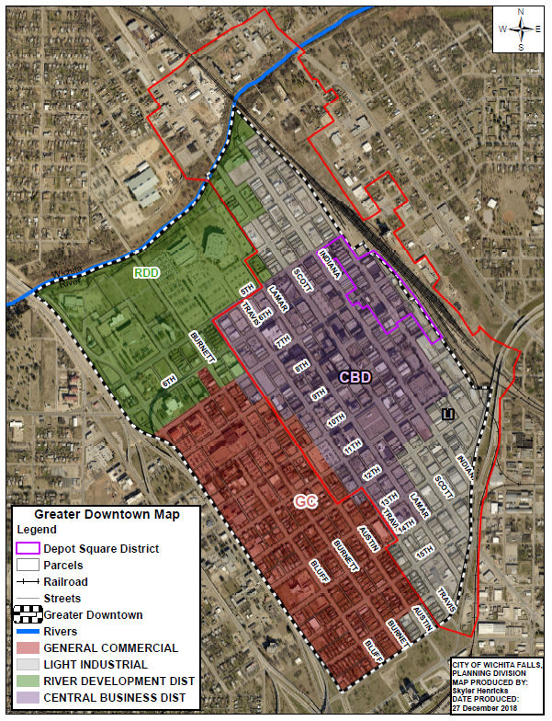
Existing Zoning Greater Downtown Overview: 4 zoning districts: RDD – River Dev’t District CBD – Central Business District GC – General Commercial LI – Light Industrial 824 parcels: 67 - RDD parcels – 8.1% 259 - CBD parcels – 31.4% 341 - GC parcels – 41.4% 157 - LI parcels – 19.1% 1 Historic District (purple) 1 TIF Zone (red)
Notes:
WF downtown foot print is extremely large for a city of our size – 824 parcels in greater downtown.
Four existing Zoning Districts in Greater Downtown:
Majority of parcels currently zoned for:
General Commercial (red) – comprises 41% of downtown area
Central Business District (purple) – comprises 31% of downtown area
RDD Zone is focused on the northwestern sector of downtown BUT extends well beyond the downtown area to include Lucy Park, portion of the cemetery, land north of the river including the Bridwell Ag Center and land east of the RR tracks new Front and Wichita Streets.
River Dev’t District includes significant land area beyond the downtown core – 475.3 acres; Only a small, 8% section of RDD falls in greater downtown but it’s a very important area to the function of greater downtown.
Light Industrial (grey) – comprises 19% of greater downtown

Slide 8
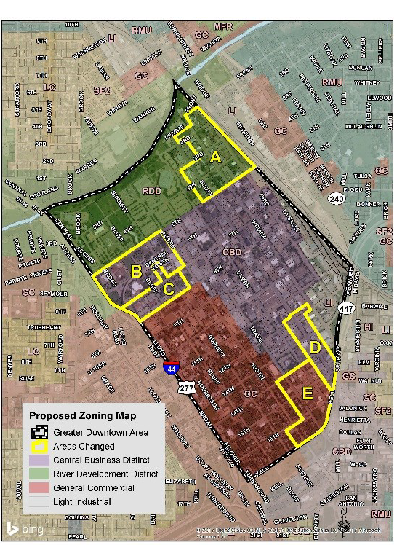
Downtown Strategic Plan Recommendations from Freese & Nichols Diagnostic Report Consider 5 rezone areas: A – north/east section; LI change to RDD-D; 52 parcels B – west section; RDD change to CBD; 37 parcels C – west section; GC change to CBD; 24 parcels D – south/central section; LI change to CBD; 27 parcels E – south section; LI change to GC-D; 43 parcels 183 parcels identified for zone change (22% parcels downtown)
Notes:
Freese & Nichols recommendations:
Examine appropriate boundaries for the River Dev’t District and scale back to focus on river corridor
Review vision for downtown and assess existing conflicts between current land uses, desired land uses and zoning designations
RDD boundary is now 5th St to the River from Broad to Ohio/RR tracks, includes changes with Area A and B; Zone will expand by 3 acres with the realignment proposal
Focus of zone is to provide a facility for recreation and leisure and to enhance tourism.
CBD boundary with proposed changes for Area B, C and D by adding 88 lots (11% expansion); will extend to encompass key gateway corridors noted in the Downtown Strategic Plan of 6th and 8th Street along with Scott Ave.
GC boundary shrinks in the northwest (Area C) but increases by Lamar/Travis along Kell Blvd.; changes with Area E; anticipate a 2-3% expansion of zone overall gain of 19 parcels.
LI boundary removed in the NE (Area A); shrunk in the southern portion of the district (Area E) so only includes Indiana along Kell to 11th and Ohio east to the RRtracks.;
Zone reduced by 15% with boundary adjustments.
Potential consideration of a small strip east of LaSalle alley, approximately 6 lots from 6th – 9th St moving to CBD as their uses align more closely with commercial rather than the railroad and industrial

Slide 9
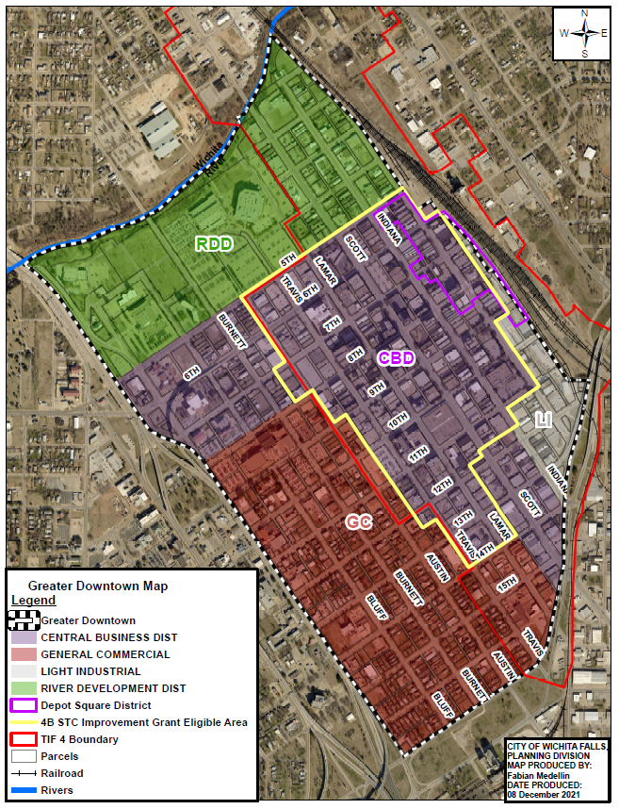
Proposed Zoning Greater Downtown Recommendations from Freese & Nichols Diagnostic Report Overview: 824 parcels 4 - Zoning Districts: RDD-D – River Dev’t District-Downtown CBD – Central Business District GC-D – General Commercial-Downtown LI-D – Light Industrial-Downtown 1 – Depot Square Historic District (purple) 1 - TIF #4 Zone (red) 1 - 4B STC Improvement Zone (yellow)
Notes:
Overview of proposed zoning boundaries based on the Zoning Diagnostic Report.
NOTE:
The increased size of the CBD does not result in any changes to the 4B STC eligibility boundary.
Existing 4B STC Downtown Improvement Matching Grant eligibility boundary established in 2015 will remain the same as outlined in yellow.

Slide 10
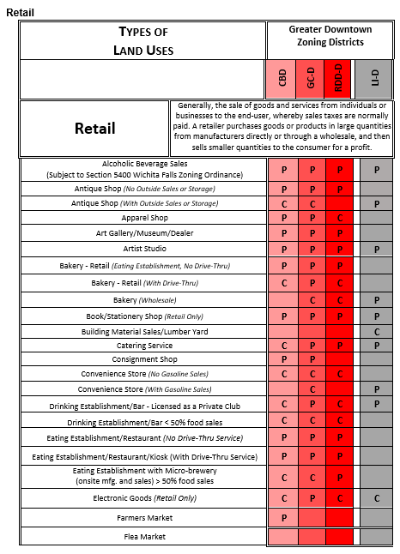
Downtown Zoning Use Table
Listing of detailed land uses by zone & category based on:
Residential
Institutional-Governmental
Office
Services (Personal & Business)
Retail
Transportation & Auto Services
Amusement & Recreation
Commercial & Wholesale Trade
Light Assembly/Industrial
Mineral Extraction
Temporary Uses
Uses either: P - permitted; C – conditional; or not allowed
Encourage mixed-use developments
Notes:
Downtown Use Table:
If a use is not listed or the box is blank - it’s not allowed in a particular district or any of the downtown districts
Unless noted otherwise, uses listed in the Downtown Use Table will be the predominant use of the land.
If a use is noted as accessory, it is only accessory to a permitted use.
Conditional Use – is a use that requires additional review to determine if appropriate
Purpose - to allow for review of uses which would not be appropriate generally or without certain restrictions throughout a zoning district but which, if controlled as to the number, area, location or relation to the neighborhood, would promote the health, safety, and welfare of the community
Triggers review by staff and notification process to adjacent property owners and Planning & Zoning Commission review/determination

Slide 11
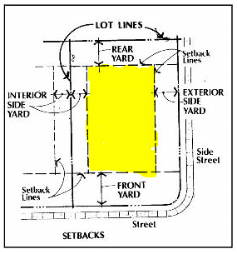
Development Standards
What are Development Standards ?
Regulations that limit the size, bulk, or siting conditions of particular types
of buildings or uses located within any designated district.
Elements related to:
Setbacks – front, interior side, exterior side, rear
Height
Building coverage – amount of lot area covered by buildings
Setback Reductions:
CBD: Unchanged; already able to build to property line
GC-D: Front-15ft; Interior Side-0ft; Ext. Side-15ft; Rear-0ft
RDD-D: Front-10ft; Interior Side-0ft; Ext. Side-15ft; Rear-0ft;
Building Coverage-No maximum
LI-D: Front-15ft; Interior Side-0ft; Ext. Side-15ft; Rear-0ft
Notes:
Minimum setbacks were re-assessed to help provide more options for future development including: front, interior side and exterior side.
Existing setbacks in most of the downtown zones (RDD, GC and LI) required:
25ft front setback
25ft exterior side setback
15ft interior side setback
50ft – minimum lot width
CBD – no change in setbacks as already ability to build up to the property line in downtown core
GC-D Propose:
15ft front setback – 10ft reduction; Interior side setback: Residential – 5ft; All other uses – No minimum; 15ft exterior side setback – 10ft reduction
Rear setback: Residential – 5ft; 1ft from alley; All other uses – No minimum
Building coverage/Open space limitations - related single-family and multi-family residential projects
RDD Propose: 10ft front setback; No interior side setback; 15ft exterior side setback; no minimum rear setback
LID Propose:

Slide 12
Non-Conforming Uses
What is a Non-Conforming Use?
A legal use which is not a permitted use in that zoning district and existed prior to enactment of zoning within the city but because of changes in zoning ordinance regulations, no longer complies with ordinance requirements
Examples include:
Land use changes;
Setback changes;
Building height/lot coverage;
Parking
What if a Non-Conforming Use Closes?
Use discontinues operation or remains vacant or unused for 2-years in Wichita Falls;
non-conforming status terminates;
Appeal option via Planning & Zoning Commission for conditional use permit (CUP) to
consider continuance based on a case-by-case basis; provides forum for public input
Notes:
The appeal option provides a public process for anyone to comment on the conditional use request extending a non-conforming use status.
Notices are required to be sent to adjacent property owners and meetings are publicly posted.
Example: Case 22-12 – 312 Hilltop Ave – allow residential expansion in a Light Industrial Zoning District

Slide 13
Non-Conforming Use – Downtown
What’s typical for compliance?
Researched 11 comparison cities
Results ranged from 3mo – 2years
Recommendation:
1-year expiration for non-conforming uses in Greater Downtown
Appeal option available on a case-by-case basis via Planning & Zoning Commission
Comparison City | Expiration Date
Abilene | 6 months
Beaumont | 1 year
College Station | 3 months
Denton | 1 year
Edinburg | either 12 or 6 month consecutive*
Lewisville | 3 months
McAllen | 6 months consecutive
Odessa | 6 months or 18 months in 3yr period
San Angelo | 1 year
Tyler | 6 months
Waco | 2 years
Wichita Falls | 2 years
Notes:
Research:
City of Wichita Falls – 2 years
*Edinburg – 2 part categorization:
Minor Non-conforming Use – discontinued for 12 months;
Major Non-conforming Use – discontinuance for 6 consecutive months
Results:
1 – 2yrs (Waco);
4 – 1yrs (Beaumont, Denton, Edinburg, San Angelo);
5 – 6mo (Abilene, Edinburg, McAllen, Odessa, Tyler);
2 – 3mo (College Station & Lewisville)

Slide 14
Definitions
Purpose of Definitions Section ?
From a land use perspective, definitions serve the following purpose:
Simplify text in the ordinance;
Establish precise meaning of a word or phrase, eliminates ambiguity;
Transform technical terms into understandable, useable terminology
What is Changing ?
Incorporating new definition section (Sec. 2100) addressing detailed list of uses
proposed in Downtown Zoning Use Table;
Clarify terms to ensure compliance with federal case law and disability standards:
Terms for Removal:
Adult Daycare Facility, Foster Care Facility, Group Homes, Halfway House,
Personal Care Home and Residential Care Facility
Updated Terms:
Household Care Facility and Structured Sober Living Facility
Notes:
Definition Revisions:
Household Care Facility – provides all encompassing definition covering elderly, disable, orphaned, abandoned, abused or neglected children, victims of domestic violence, persons temporarily homeless due to fire/natural disaster living together with no more than 2 supervisory personnel.
Structured Sober Living Facility – new definition to address alcoholic and narcotic recovery group living scenarios; in recent years have rec’d an increased volume of calls inquiring about use of large single family homes for these uses this allows the use to be defined and added to various zoning districts to provide some level of dev’t parameters.

Slide 15
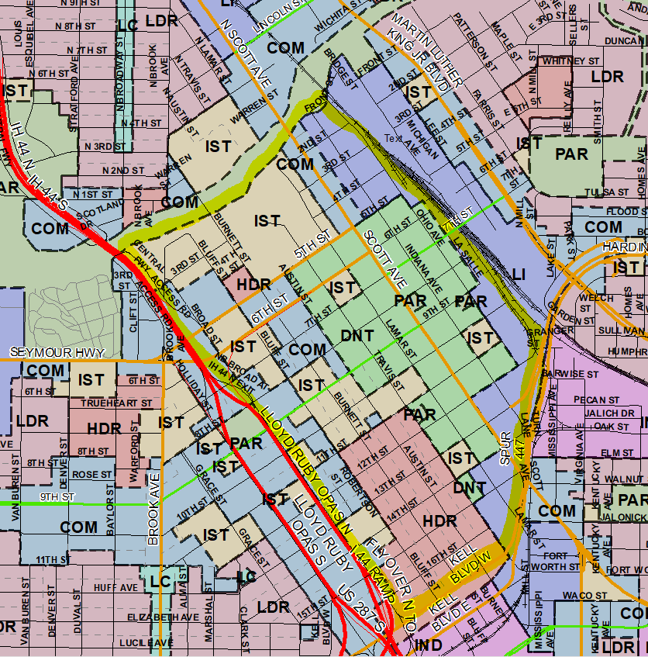
Land Use Plan Amendment
What is a Land Use Plan?
Basic element of city’s comprehensive plan.
Land-use plan serves as a guide to official decisions regarding the distribution and intensity
of private development, as well as public decisions on location of future public facilities/open spaces.
Designates future use or reuse of land within a municipality’s planning area, and policies
used to arrive at decisions in the plan.
Existing Downtown Land Use Categories:
COM – Commercial
DNT – Downtown
HDR – High Density Residential
IND – Industrial
IST – Institutional
PAR – Parks & Open Space

Slide 16
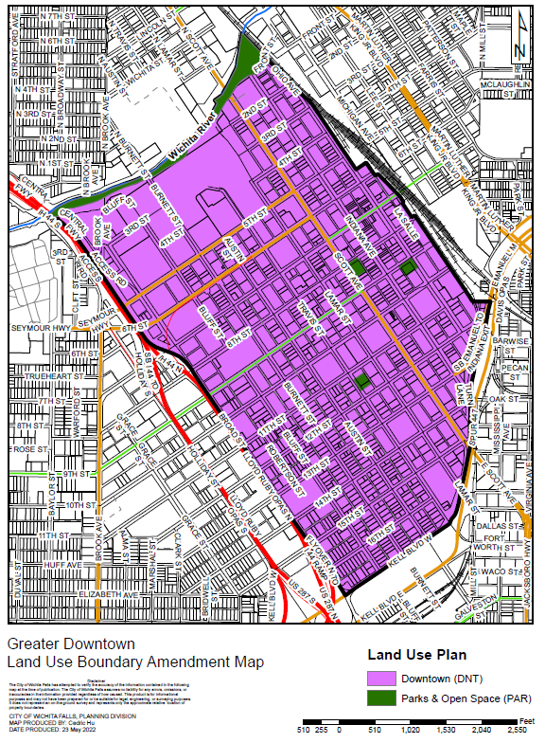
Land Use Plan Amendment
Recommend Consolidation
Proposed Land Use Categories:
DNT – Downtown
PAR – Parks & Open Space

Slide 17
Next Steps: Projected Timeline
June 8: Planning and Zoning Commission - Work Session
July 13: Planning and Zoning Commission - Ordinance Consideration
July 19: Council Update
Aug 2: Council - Ordinance Consideration
Notes:
Proposed zone changes & the draft Downtown Use Table presented during this work session to both the Planning & Zoning Commission and the Downtown Zoning Stakeholder Committee initially created in July 2021 (owners/tenants throughout downtown to assist staff through Diagnostic implementation phase)
2nd public meeting – draft ordinance: Text Amendment with Planning & Zoning Commission to request a recommendation for City Council consideration in July
Council update after P&Z review & consideration.
Potential council consideration at a public hearing in August 2022.

Slide 18
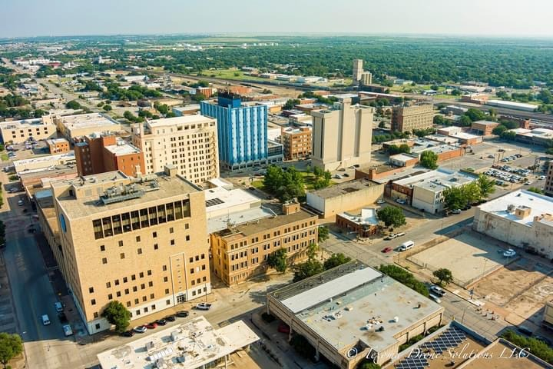
Questions/Comments?

